Slide 1
Motivação
16
16 - 1

Slide 2
Objetivos
Definir motivação.
Comparar e contrastar as primeiras teorias da motivação.
Comparar e contrastar as teorias contemporâneas da motivação.
Discutir assuntos atuais relativos à motivação.
16 - 2

Slide 3
O que é a Motivação?
  Motivação - É o processo pelo qual os esforços pessoais são energizados, dirigidos e sustentados em direção a um objetivo que se pretende alcançar.
    Energia: uma medida de intensidade.
    Direção: relativamente às metas organizacionais.
    Persistência: manutenção do esforço para alcançar os objetivos, apesar das dificuldades.
16 - 3
Notes:
Motivation refers to the process by which a person’s efforts are energized, directed, and sustained toward attaining a goal. This definition has three key elements: energy, direction, and persistence.
The energy element is a measure of intensity, drive, and vigor. A motivated person puts forth effort and works hard. However, the quality of the effort must be considered as well as its intensity. High levels of effort don’t necessarily lead to favorable job performance unless the effort is channeled in a direction that benefits the organization. Effort directed toward and consistent with organizational goals is the kind of effort we want from employees. Finally, motivation includes a persistence dimension. We want employees to persist in putting forth effort to achieve those goals.

Slide 4
Teorias iniciais sobre a Motivação
Maslow: Hierarquia das Necessidades
McGregor: Teorias X e Y
Herzberg: A Teoria dos Dois Fatores
McClelland: A Teoria das Três Necessidades
16 - 4
Notes:
We begin by looking at four early motivation theories: Maslow’s hierarchy of needs, McGregor’s theories X and Y, Herzberg’s two-factor theory, and McClelland’s three needs theory. Although more valid explanations of motivation have been developed, these early theories are important because they represent the foundation from which contemporary motivation theories were developed and because many practicing managers still use them.

Slide 5
hierarquia das necessidades de Maslow
A Teoria da Hierarquia das Necessidades
Necessidades humanas: fisiológicas, segurança, sociais, estima e auto-realização — formam uma hierarquia.
Necessidades fisiológicas
As necessidades de comida, bebida, abrigo, satisfação sexual e outras necessidades físicas.
16 - 5
Notes:
The best-known theory of motivation is probably Abraham Maslow’s hierarchy of needs theory. Maslow was a psychologist who proposed that within every person is a hierarchy of five needs:
1. Physiological needs: A person’s needs for food, drink, shelter, sex, and other physical requirements.

Slide 6
hierarquia das necessidades de Maslow (cont.)
Necessidades de segurança
As necessidades de proteção de eventos materiais e/ou emocionais que possam pôr em causa a pessoa ou o seu mais básico bem-estar.
Necessidades sociais
As necessidades de afeto, pertença, aceitação e amizade.
16 - 6
Notes:
2. Safety needs: A person’s needs for security and protection from physical and emotional harm as well as assurance that physical needs will continue to be met.
3. Social needs: A person’s needs for affection, belongingness, acceptance, and friendship.

Slide 7
hierarquia das necessidades de Maslow (cont.)
Necessidades de estima
As necessidades pessoais relacionados com fatores internos como a auto-imagem, a autonomia, e a necessidade de realizações/conquistas e com fatores externos como o status, o reconhecimento e a atenção.
Necessidades de auto-realização
A necessidade de uma pessoa em atingir o seu potencial.
16 - 7
Notes:
4. Esteem needs: A person’s needs for internal esteem factors such as self-respect, autonomy, and achievement and external esteem factors such as status, recognition, and attention.
5. Self-actualization needs: A person’s needs for growth, achieving one’s potential, and self-fulfillment; the drive to become what one is capable of becoming.

Slide 8
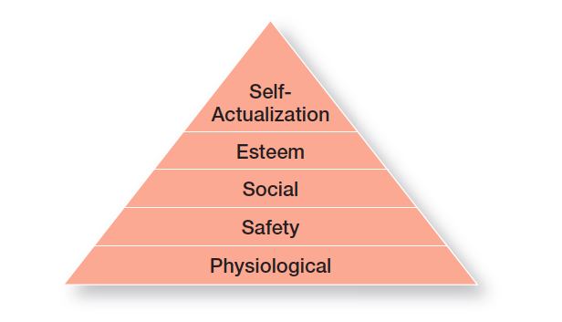
figura 16-1 hierarquia das necessidades de Maslow
16 - 8
Notes:
Maslow argued that each level in the needs hierarchy must be substantially satisfied before the next need becomes dominant. An individual moves up the needs hierarchy from one level to the next. (See Exhibit 16-1.) In addition, Maslow separated the five needs into higher and lower levels. Physiological and safety needs were considered lower-order needs; social, esteem, and self-actualization needs were considered higher-order needs. Lower-order needs are predominantly satisfied externally, while higher-order needs are satisfied internally.

Slide 9
Teoria X e Teoria Y de McGregor
Teoria X – Assume-se que os trabalhadores não gostam de trabalhar, são preguiçosos, evitam as responsabilidades e têm que ser coagidos para trabalhar.
Teoria Y – Assume-se que os trabalhadores são criativos, gostam de trabalhar, procuram responsabilidade e são capazes de se automotivarem e de se autodirigirem.
16 - 9
Notes:
Douglas McGregor is best known for proposing two assumptions about human nature: Theory X and Theory Y. Very simply, Theory X is a negative view of people that assumes workers have little ambition, dislike work, want to avoid responsibility, and need to be closely controlled to work effectively. Theory Y is a positive view that assumes employees enjoy work, seek out and accept responsibility, and exercise self-direction. McGregor believed that Theory Y assumptions should guide management practice and proposed that participation in decision-making, responsible and challenging jobs, and good group relations would maximize employee motivation.

Slide 10
Teoria dos dois fatores de Herzberg
Teoria dos dois fatores (motivacionais e higiénicos)
Segundo esta teoria da motivação, os fatores intrínsecos (relativos à(s) tarefa(s) e ao desenvolvimento pessoal) estão relacionados com a satisfação e motivação no trabalho, e os fatores extrínsecos (relativos às condições de trabalho) estão relacionados com a insatisfação no trabalho.
16 - 10
Notes:
Frederick Herzberg’s two-factor theory (also called motivation-hygiene theory) proposes that intrinsic factors are related to job satisfaction, while extrinsic factors are associated with job dissatisfaction.

Slide 11
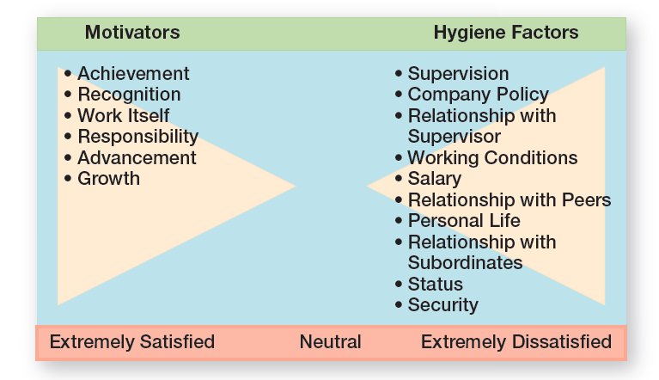
figura 16-2 teoria dos dois fatores de Herzberg
16 - 11
Notes:
Herzberg wanted to know when people felt exceptionally good (satisfied) or bad (dissatisfied) about their jobs. (These findings are shown in Exhibit 16-2.) He concluded that the replies people gave when they felt good about their jobs were significantly different from the replies they gave when they felt badly. Certain characteristics were consistently related to job satisfaction (factors on the left side of the exhibit), and others to job dissatisfaction (factors on the right side).

Slide 12
Teoria dos dois fatores de Herzberg (cont.)
Fatores Higiénicos
Fatores que eliminam a insatisfação no trabalho, mas que não motivam.
Fatores Motivadores
Fatores que aumentam a satisfação e a motivação.
16 - 12
Notes:
The extrinsic factors that create job dissatisfaction were called hygiene factors. When these factors are adequate, people won’t be dissatisfied, but they won’t be satisfied (or motivated) either. To motivate people, Herzberg suggested emphasizing motivators, the intrinsic factors having to do with the job itself.

Slide 13
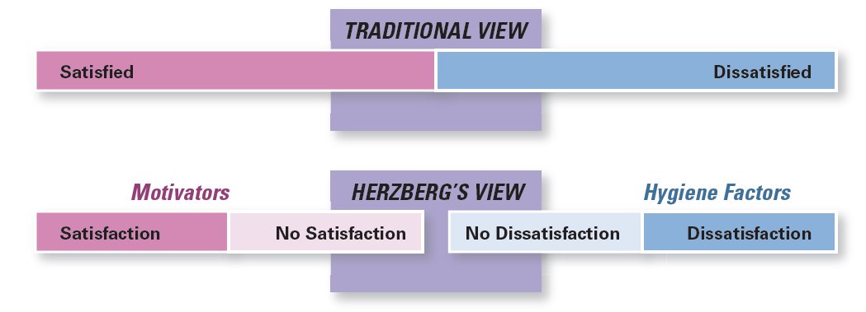
figura 16-3
Satisfação e insatisfação
Nota: Segundo esta teoria, o oposto de satisfação não é a insatisfação, é a não satisfação.
16 - 13
Notes:
Herzberg believed the data suggested that the opposite of satisfaction was not dissatisfaction, as traditionally had been believed. Removing dissatisfying characteristics from a job would not necessarily make that job more satisfying (or motivating). As shown in Exhibit 16-3, Herzberg proposed that a dual continuum existed: The opposite of “satisfaction” is “no satisfaction,” and the opposite of “dissatisfaction” is “no dissatisfaction.”

Slide 14
Teoria das três necessidades
Teoria das Três Necessidades
Existem três necessidades (Sucesso, Poder e Afiliação) que os indivíduos adquirem (i.e. não inatas), que são a base da motivação no trabalho.
16 - 14
Notes:
David McClelland and his associates proposed the three-needs theory, which says three acquired (not innate) needs are major motives in work. These three needs include the need for achievement (nAch), the drive to succeed and excel in relation to a set of standards; the need for power (nPow), the need to make others behave in a way they would not have behaved otherwise; and the need for affiliation (nAff), the desire for friendly and close interpersonal relationships.
People with a high need for achievement are striving for personal achievement rather than for the trappings and rewards of success. They have a desire to do something better or more efficiently than it’s been done before.

Slide 15
Teoria das três necessidades (Cont.)
    Necessidade de Realização
      A vontade de se exceder a si mesmo/a e de se destacar socialmente.
    Necessidade de Poder
      A necessidade de influenciar e, de deter um status social que lhe permita influenciar, o comportamento dos outros.
    Necessidade de Afiliação
      O desejo de pertencer a um grupo(s) social(ais) e de interagir e formar relações com outras pessoas.
16 - 15
Notes:
The other two needs in this theory haven’t been researched as extensively as the need for achievement. However, we do know that the best managers tend to be high in the need for power and low in the need for affiliation.

Slide 16
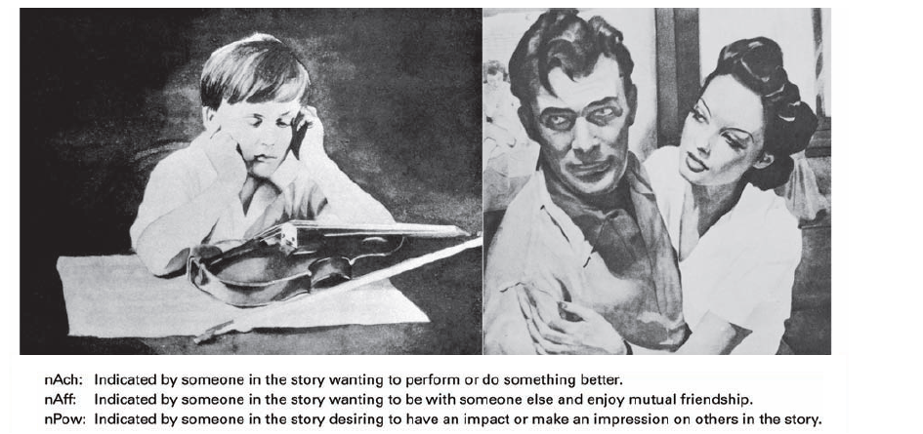
figura 16-4
Fonte: Thematic Apperception test
16 - 16
Notes:
All three of these needs can be measured by using a projective test (known as the Thematic Apperception Test or TAT) in which respondents react to a set of pictures. Each picture is briefly shown to a person who writes a story based on the picture. (See Exhibit 16-4 for some examples.) Trained interpreters then determine the individual’s levels of nAch, nPow, and nAff from the stories written.

Slide 17
Teorias contemporâneas da motivação
Teoria do estabelecimento de objetivos – a proposição de que objetivos específicos aumentam a performance e que objetivos ambiciosos, quando aceites, resultam em desempenhos mais elevados do que objetivos fáceis.
Autoeficácia – a crença que um indivíduo tem de que consegue realizar uma determinada tarefa ou conjunto de tarefas.
16 - 17
Notes:
Research provides substantial support for goal-setting theory, which says that specific goals increase performance and that difficult goals, when accepted, result in higher performance than do easy goals.
Self-efficacy refers to an individual’s belief that he or she is capable of performing a task. The higher your self-efficacy, the more confidence you have in your ability to succeed in a task. So, in difficult situations, we find that people with low self-efficacy are likely to reduce their effort or give up altogether, whereas those with high self-efficacy will try harder to master the challenge.

Slide 18
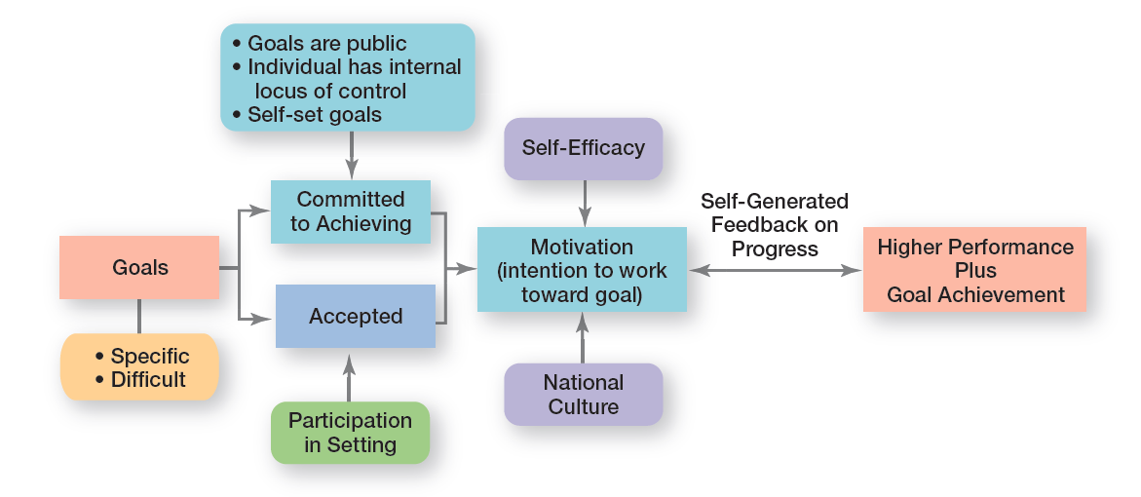
figura 16-5
Teoria do estabelecimento de objetivos
16 - 18
Notes:
Exhibit 16-5 summarizes the relationships among goals, motivation, and performance. One overall conclusion is that the intention to work toward hard and specific goals is a powerful motivating force. Under the proper conditions, it can lead to higher performance. However, no evidence indicates that such goals are associated with increased job satisfaction.

Slide 19
Teoria do reforço
Teoria do Reforço – Teoria que diz que o comportamento é determinado pelas suas consequências.
Reforços - consequências imediatas que se seguem ao comportamento e que aumentam a probabilidade que esse comportamento seja repetido.
16 - 19
Notes:
Reinforcement theory says that behavior is a function of its consequences. Those consequences that immediately follow a behavior and increase the probability that the behavior will be repeated are called reinforcers. Reinforcement theory ignores factors such as goals, expectations, and needs. Instead, it focuses solely on what happens to a person when he or she does something.

Slide 20
Desenho de funções motivadoras
Desenho da função
A forma como as tarefas são combinadas para em conjunto formarem uma função.
Âmbito da função – o número de diferentes tarefas requeridas pela função e a frequência com que se repetem.
Alargamento de funções – expansão horizontal da função que ocorre através de um aumento do seu âmbito.
16 - 20
Notes:
Because managers want to motivate individuals on the job, we need to look at ways to design motivating jobs. We use the term job design to refer to the way tasks are combined to form complete jobs. The jobs people perform in an organization should not evolve by chance. Managers should design jobs deliberately and thoughtfully to reflect the demands of the changing environment; the organization’s technology; and employees’ skills, abilities, and preferences.
An early effort at overcoming the drawbacks of job specialization involved horizontally expanding a job through increasing job scope—the number of different tasks required in a job and the frequency with which these tasks are repeated. For instance, a dental hygienist’s job could be enlarged so that in addition to cleaning teeth, he or she is pulling patients’ files, refiling them when finished, and sanitizing and storing
instruments. This type of job design option is called job enlargement.

Slide 21
Desenho de funções motivadoras (cont.)
Profundidade da função – Nível de controlo que os empregados têm sobre o seu trabalho.
Enriquecimento de funções – expansão vertical da função, que ocorre através da adição de tarefas de planeamento e de avaliação à mesma.
16 - 21
Notes:
Another approach to job design is the vertical expansion of a job by adding planning and evaluating responsibilities—job enrichment. Job enrichment increases job depth, which is the degree of control employees have over their work. In other words, employees are empowered to assume some of the tasks typically done by their managers. Thus, an enriched job allows workers to do an entire activity with increased freedom, independence, and responsibility.
Even though many organizations implemented job enlargement and job enrichment programs and experienced mixed results, neither
approach provided an effective framework for managers to design motivating jobs. But the job characteristics model (JCM) does. It identifies five core job dimensions, their interrelationships, and their impact on employee productivity, motivation, and satisfaction.

Slide 22
Desenho de funções motivadoras (cont.)
O modelo das características do trabalho
Uma metodologia que permite analisar e desenhar funções que identifica: as 5 principais dimensões duma função, as suas inter-relações e os seus impactos nos resultados.
16 - 21
Notes:
Another approach to job design is the vertical expansion of a job by adding planning and evaluating responsibilities—job enrichment. Job enrichment increases job depth, which is the degree of control employees have over their work. In other words, employees are empowered to assume some of the tasks typically done by their managers. Thus, an enriched job allows workers to do an entire activity with increased freedom, independence, and responsibility.
Even though many organizations implemented job enlargement and job enrichment programs and experienced mixed results, neither
approach provided an effective framework for managers to design motivating jobs. But the job characteristics model (JCM) does. It identifies five core job dimensions, their interrelationships, and their impact on employee productivity, motivation, and satisfaction.

Slide 23
Cinco principais dimensões de uma função
Variedade das competências necessárias – potencial que a função tem para a realização de diferentes atividades que requerem, do trabalhador, um variado número de competências e talentos.
Identificação com a tarefa – Até que ponto a tarefa requer a realização de algo completo e identificável.
16 - 22
Notes:
These five core job dimensions are:
1. Skill variety, the degree to which a job requires a variety of activities so that an employee can use a number of different skills and talents.
2. Task identity, the degree to which a job requires completion of a whole and identifiable piece of work.

Slide 24
Cinco principais dimensões de uma função (Cont.)
.
Significância da tarefa – Que impacto tem a tarefa nas vidas, ou no trabalho, das outras pessoas? Mínimo? Substancial?
Autonomia – Até que ponto a função confere a independência ao empregado para planear o seu trabalho e escolher os meios através dos quais irá tentar atingir os seus objectivos.
16 - 23
Notes:
Task significance, the degree to which a job has a substantial impact on the lives or work of other people.
4. Autonomy, the degree to which a job provides substantial freedom, independence, and discretion to the individual in scheduling the work and determining the procedures to be used in carrying it out.

Slide 25
Cinco principais dimensões de uma função (Cont.)
Feedback – Nível e a frequência da informação que o empregado recebe sobre a eficiência e eficácia da sua performance.
16 - 24
Notes:
5. Feedback, the degree to which doing work activities required by a job results in an individual obtaining direct and clear information about the effectiveness of his or her performance.

Slide 26
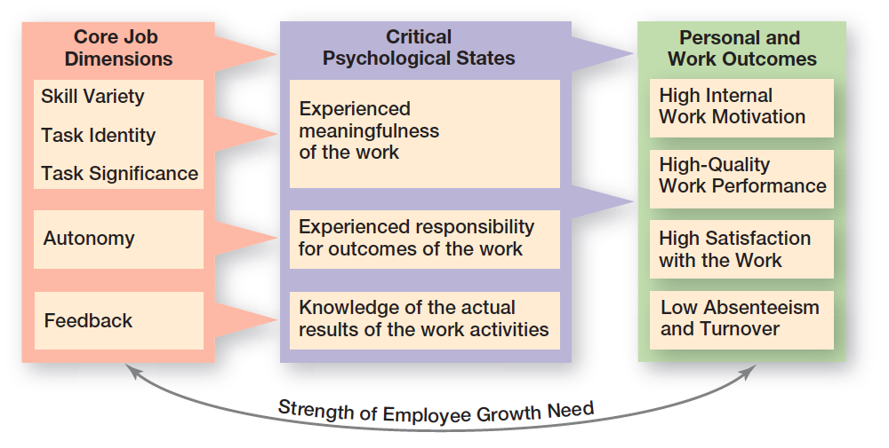
figura 16-6 modelo das Características do trAbalho
16 - 25
Notes:
The JCM is shown in Exhibit 16-6. Notice how the first three dimensions—skill variety, task identity, and task significance—combine to create meaningful work.

Slide 27
Abordagens do redesenho da função
Perspetiva relacional do desenho da função – as tarefas e funções dos empregados estão cada vez mais dependentes de relações sociais e de interdependência entre pessoas, dentro e fora da organização.
Perspetiva proativa do desenho da função – abordagem em que os empregados tomam a iniciativa de mudar a forma como o seu trabalho é realizado.
16 - 26
Notes:
Two emerging viewpoints on job design are causing a rethink of the JCM and other standard approaches. Let’s take a look at each perspective.
The first perspective, the relational perspective of work design, focuses on how people’s tasks and jobs are increasingly based on social relationships. In jobs today, employees have more interactions and interdependence with coworkers and others both inside and outside the organization. In doing their job, employees rely more and more on those around them for information, advice, and assistance. So what does this mean for designing motivating jobs? It means that managers need to look at important components of those employee relationships such as access to and level of social support in an organization, types of interactions outside an organization, amount of task interdependence, and interpersonal feedback.
The second perspective, the proactive perspective of work design, says that employees are taking the initiative to change how their work is performed. They’re much more involved in decisions and actions that affect their work. Important job design factors according to this perspective include autonomy (which is part of the JCM), amount of ambiguity and accountability, job complexity, level of stressors,
and social or relationship context. Each of these has been shown to influence employee proactive behavior.

Slide 28
Abordagens do redesenho da função (cont.)
Praticas de trabalho de alto envolvimento – desenhadas para estimular um maior contributo e comprometimento por parte dos colaboradores.
16 - 27
Notes:
One stream of research that’s relevant to proactive work design is high involvement work practices, which are designed to elicit greater input or involvement from workers. The level of employee proactivity is believed to increase as employees become more involved in decisions that affect their work. Another term for this approach, which we discussed in an earlier chapter, is employee empowerment.

Slide 29
Teoria da equidade
Teoria da Equidade – a teoria de que um empregado compara o seu rácio de input-output (i.e. quantidade e qualidade do trabalho vs. retribuição) com o dos seus pares (ou outras pessoas relevantes).
Referentes – pessoas, sistemas (e.g. políticas salariais) ou individualidade (ex.: experiências e conhecimentos únicos, considerados valiosos) que servem para os indivíduos se compararem e avaliarem a equidade.
16 - 28
Notes:
Equity theory, developed by J. Stacey Adams, proposes that employees compare what they get from a job (outcomes) in relation to what they put into it (inputs), and then they compare their inputs–outcomes ratio with the inputs–outcomes ratios of relevant others (Exhibit 16-7). If an employee perceives her ratio to be equitable in comparison to those of relevant others, there’s no problem. However, if the ratio is inequitable, she views herself as underrewarded or overrewarded. When inequities occur, employees attempt to do something about it. The result might be lower or higher productivity, improved or reduced quality of output, increased absenteeism, or voluntary resignation.
The referent—the other persons, systems, or selves individuals compare themselves against in order to assess equity—is an important variable in equity theory.
Originally, equity theory focused on distributive justice, the perceived fairness of the amount and allocation of rewards among individuals. More recent research has focused on looking at issues of procedural justice, the perceived fairness of the process used to determine the distribution of rewards.

Slide 30
Teoria da equidade (cont.)
Justiça distributiva – perceção da justiça da distribuição das recompensas entre indivíduos.
Justiça de procedimentos - perceção da justiça do processo utilizado para determinar a distribuição das recompensas.
16 - 29
Notes:
Research shows that distributive justice has a greater influence on employee satisfaction than procedural justice, while procedural justice tends to affect an employee’s organizational commitment, trust in his or her boss, and intention to quit.

Slide 31
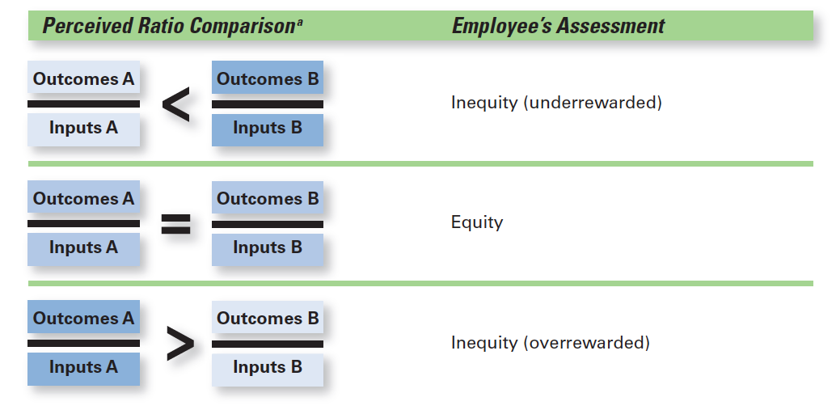
figura 16-7 teoria da equidade
16 - 30

Slide 32
Teoria das expectativas
Teoria das Expectativas
Os indivíduos tendem a atuar duma certa forma, em função de esperarem que os atos sejam seguidos de um determinado resultado, que é atrativo para o indivíduo.
16 - 31
Notes:
The most comprehensive explanation of how employees are motivated is Victor Vroom’s expectancy theory. Expectancy theory states that an individual tends to act in a certain way based on the expectation that the act will be followed by a given outcome and on the attractiveness of that outcome to the individual. It includes three variables or relationships (see Exhibit 16-8).

Slide 33
Teoria das expectativas (cont.)
Relações presentes na Teoria das Expectativas
  Expectativa (ligação esforço-performance)
    Perceção de probabilidade de ocorrência de uma determinado desempenho em função do esforço do indivíduo.
  Instrumentalidade
    Perceção de que um determinado nível de desempenho resultará na obtenção de um determinado resultado (i.e. recompensa).
  Valência
    O nível de atratividade/importância que determinado resultado tem para o indivíduo.
16 - 32
Notes:
1. Expectancy or effort–performance linkage is the probability perceived by the individual that exerting a given amount of effort will lead to a certain level of performance.
2. Instrumentality or performance–reward linkage is the degree to which the individual believes that performing at a particular level is instrumental in attaining the desired outcome.
3. Valence or attractiveness of reward is the importance an individual places on the potential outcome or reward that can be achieved on the job. Valence considers both the goals and needs of the individual.

Slide 34
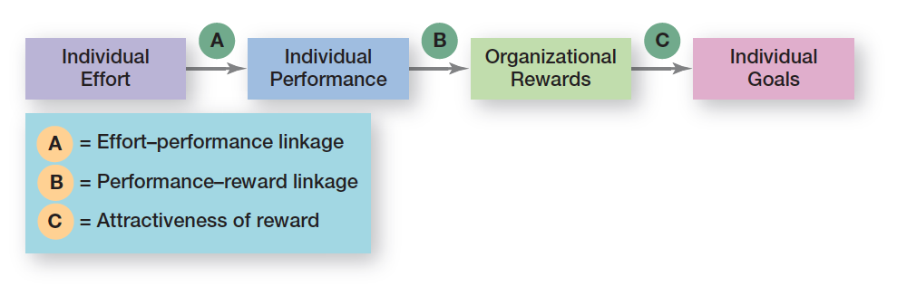
figura 16-8 teoria das expectativas
16 - 33

Slide 35
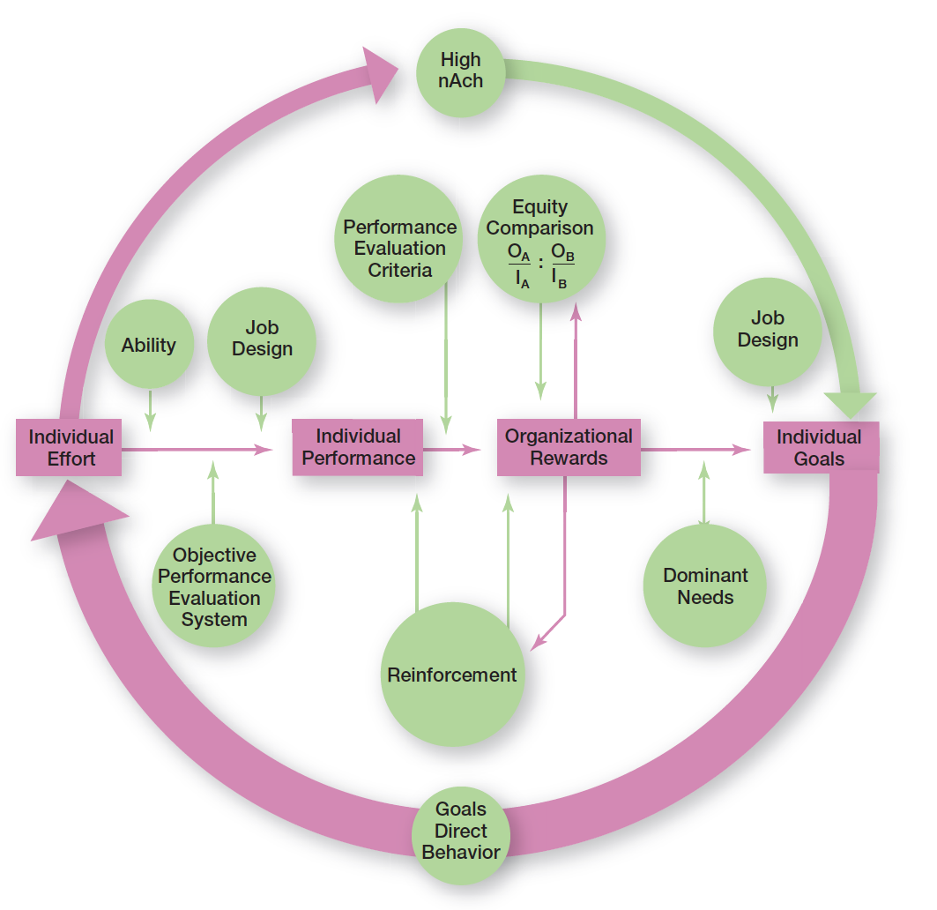
figura 16-9
Integração das teorias contemporâneas de motivação
16 - 34
Notes:
Many of the ideas underlying the contemporary motivation theories are complementary, and you’ll understand better how to motivate people if you see how the theories fit together. Exhibit 16-9 presents a model that integrates much of what we know about motivation. Its basic foundation is the expectancy model.
The individual effort box has an arrow leading into it. This arrow flows from the individual’s goals. Consistent with goal-setting theory, this goals–effort link is meant to illustrate that goals direct behavior. Expectancy theory predicts that an employee will exert a high level of effort if he or she perceives a strong relationship between effort and performance, performance and rewards, and rewards and satisfaction of personal goals. Each of these relationships is in turn influenced by certain factors. You can see from the model that the level of individual performance is determined not only by the level of individual effort but also by the individual’s ability to perform and by whether the organization has a fair and objective performance evaluation system. The performance–reward relationship will be strong if the individual perceives that performance (rather than seniority, personal favorites, or some other criterion) is what is rewarded. The final link in expectancy theory is the rewards–goal relationship. The traditional need theories come into play at this point. Motivation would be high to the degree that the rewards an individual
received for his or her high performance satisfied the dominant needs consistent with his or her individual goals.

Slide 36
Assuntos atuais sobre a motivação
A motivação em tempos de crise económica
  A crise económica deixou em dificuldades muitas empresas;
  Despedimentos, layoffs, orçamentos sem margem, atualizações salariais mínimas ou inexistentes, benefícios e bónus cortados, e aumento das cargas horárias para compensar o trabalho daqueles que já não estão na empresa — esta é a realidade de muitos trabalhadores nos dias de hoje.
16 - 35
Notes:
The economic recession of the last few years was difficult for many organizations, especially when it came to their employees. Layoffs, tight budgets, minimal or no pay raises, benefit cuts, no bonuses, long hours doing the work of those who had been laid off—this was the reality that many employees faced. As conditions deteriorated, employee confidence, optimism, and job engagement plummeted as well. As you can imagine, it wasn’t an easy thing for managers to keep employees motivated under such challenging circumstances.

Slide 37
Assuntos atuais sobre a motivação (cont.)
A gestão multicultural e os desafios que representa
  A grande maioria das teorias foram desenvolvidas por Americanos para Americanos.
  Os gestores não podem assumir que aquilo que resulta num país (com uma determinada cultura), pode ser simplesmente importado para outro e esperarem que resulte (igualmente) bem.
16 - 36
Notes:
In today’s global business environment, managers can’t automatically assume motivational programs that work in one geographic location are going to work in others. Most current motivation theories were developed in the United States by Americans and about Americans. Maybe the most blatant pro-American characteristic in these theories is the strong emphasis on individualism and achievement. For instance, both goal-setting and expectancy theories emphasize goal accomplishment as well as rational and individual thought.

Slide 38
Assuntos atuais sobre a motivação (cont.)
Motivação de grupos especiais de empregados
  Semana de trabalho comprimida
  Horários flexíveis (e.g. isenção de horário - flextime)
  Partilha do trabalho (job sharing)
  Teletrabalho (telecommuting)
16 - 37
Notes:
To maximize motivation among today’s workforce, managers need to think in terms of flexibility. For instance, studies tell us that men place more importance on having autonomy in their jobs than women. In contrast, the opportunity to learn, convenient and flexible work hours, and good interpersonal relations are more important to women. Many organizations have developed flexible work arrangements—such as compressed workweeks, flextime, and job sharing that recognize different needs.

Slide 39
Assuntos atuais sobre a motivação (cont.)
A motivação dos profissionais
  Características dos profissionais
    Um forte e de longo-prazo comprometimento à sua área de especialização;
    Leais à profissão e não necessariamente ao empregador;
    Necessidade permanente de actualização/formação
    A sua semana de trabalho não se define por ser das 9:00 às 18:00.
16 - 38
Notes:
In contrast to a generation ago, the typical employee today is more likely to be a professional with a college degree than a blue-collar factory worker. Professionals are different from nonprofessionals. They have a strong and long-term commitment to their field of expertise. Their chief reward is the work itself. Professionals also value support. They want others to think that what they are working on is important. That may be true for all employees, but professionals tend to be focused on their work as their central life interest, whereas nonprofessionals
typically have other interests outside of work that can compensate for needs not met on the job.

Slide 40
Assuntos atuais sobre a motivação (cont.)
A motivação de trabalhadores contingentes
  Passarem a ser efectivos/permanentes;
  Oportunidade para formação;
  Equidade na remuneração.
16 - 39
Notes:
What will motivate involuntarily temporary employees? An obvious answer is the opportunity to become a permanent employee. In cases in which permanent employees are selected from a pool of temps, the temps will often work hard in hopes of becoming permanent. A less obvious answer is the opportunity for training. The ability of a temporary employee to find a new job is largely dependent on his or her skills.
In motivating minimum-wage employees, managers might look at employee recognition programs. Many managers also recognize the power of praise although these “pats on the back” must be sincere and given for the right reasons.

Slide 41
Assuntos atuais sobre a motivação (cont.)
A motivação de empregados com baixas qualificações e salário mínimo
  Programas de reconhecimento;
  Feedback (frequente e sincero);
  Formação.
16 - 39
Notes:
What will motivate involuntarily temporary employees? An obvious answer is the opportunity to become a permanent employee. In cases in which permanent employees are selected from a pool of temps, the temps will often work hard in hopes of becoming permanent. A less obvious answer is the opportunity for training. The ability of a temporary employee to find a new job is largely dependent on his or her skills.
In motivating minimum-wage employees, managers might look at employee recognition programs. Many managers also recognize the power of praise although these “pats on the back” must be sincere and given for the right reasons.

Slide 42
Desenho de programas de remunerações apropriados
Gestão de livro aberto (Open-book management)
As contas (e.g. demonstrações financeiras) da empresa estão disponíveis para a consulta de qualquer empregado.
16 - 40
Notes:
Many organizations of various sizes involve their employees in workplace decisions by opening up the financial statements (the “books”). They share that information so employees will be motivated to make better decisions about their work and better able to understand the implications of what they do, how they do it, and the ultimate impact on the bottom line. This approach is called openbook management and many organizations are using it.
Employee recognition programs consist of personal attention and expressing interest, approval, and appreciation for a job well done. They can take numerous forms.
Pay-for-performance programs are variable compensation plans that pay employees on the basis of some performance measure. Piece-rate pay plans, wage incentive plans, profit-sharing, and lump-sum bonuses are examples. What differentiates these forms of pay from more traditional compensation plans is that instead of paying a person for time on the job, pay is adjusted to reflect some performance measure.

Slide 43
Desenho de programas de remunerações apropriados (Cont.)
Programas para reconhecimento dos empregados – desenhados para dar a atenção e expressar o interesse, aprovação e agradecimento, por um trabalho bem sucedido.
Programas de remunerações indexadas ao desempenho – Planos de remunerações variáveis em que se remunera os empregados com base no seu desempenho.
16 - 40
Notes:
Many organizations of various sizes involve their employees in workplace decisions by opening up the financial statements (the “books”). They share that information so employees will be motivated to make better decisions about their work and better able to understand the implications of what they do, how they do it, and the ultimate impact on the bottom line. This approach is called openbook management and many organizations are using it.
Employee recognition programs consist of personal attention and expressing interest, approval, and appreciation for a job well done. They can take numerous forms.
Pay-for-performance programs are variable compensation plans that pay employees on the basis of some performance measure. Piece-rate pay plans, wage incentive plans, profit-sharing, and lump-sum bonuses are examples. What differentiates these forms of pay from more traditional compensation plans is that instead of paying a person for time on the job, pay is adjusted to reflect some performance measure.

Slide 44


